Slide 1
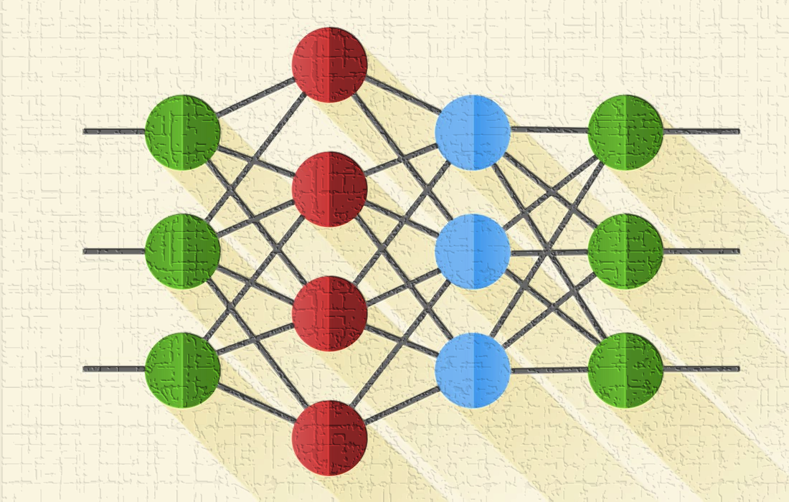

Lecture 8: Multilayer Perceptron (MLP)
CSE445 Machine Learning
Dr. Jilan Samiuddin (JSA)
Assistant Professor
North South University

Slide 2
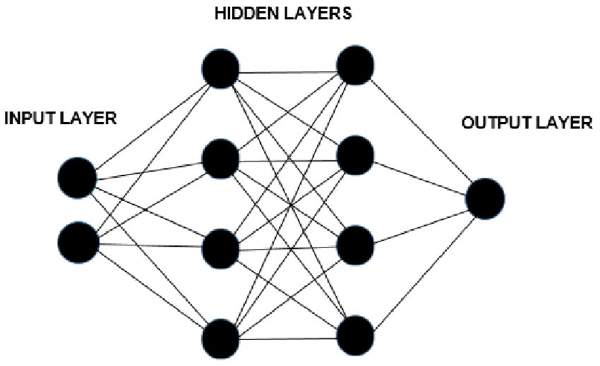
Introduction
MLPs are neural network (NN) models inspired by the human brain
They consist of interconnected nodes or neurons that process data
These models learn patterns from data
MLPs are used for tasks such as pattern recognition, decision-making, regression, classification, etc.

Slide 3
Understanding MLPs
MLPs can learn and identify patterns directly from data without relying on pre-defined rules, i.e.,
Learn the patterns automatically by adjusting weights
Based purely on exposure to examples (data)
Find non-obvious correlations and nonlinear relationships
Key components of neural networks include:
Neurons: Basic units that receive inputs and apply a threshold and activation function
Connections: Pathways between neurons that transmit information
Weights and Biases: Parameters that control the strength and influence of each connection
Propagation Functions: Processes that manage how data moves across neuron layers
Learning Rule: The method used to update weights and biases to enhance model accuracy.

Slide 4
Layers in MLPs
Input Layer:
Receives the input data
Each neuron corresponds to one feature of the input
Hidden Layers:
Perform the main computations in the network
Can consist of one or more layers
Each neuron transforms inputs into representations useful for the next layer
Output Layer:
Generates the final result of the network
The output format depends on the task (e.g., classification or regression)

Slide 5
Working of MLPs
Forward Propagation
Input data passes through the network layer by layer
Each neuron computes a weighted sum of its inputs and applies an activation function
Produces the output (prediction) at the final layer
Backpropagation
Compares the predicted output to the actual label (via a loss function)
Calculates the gradient of the loss with respect to each weight using the chain rule
Propagates these errors backward through the network
Iteration (Training Loop)
Weights and biases are updated using an optimization algorithm (e.g., Gradient Descent)
The process repeats over multiple epochs (full passes through the training data)
Each iteration improves the model's accuracy by reducing the loss

Slide 6
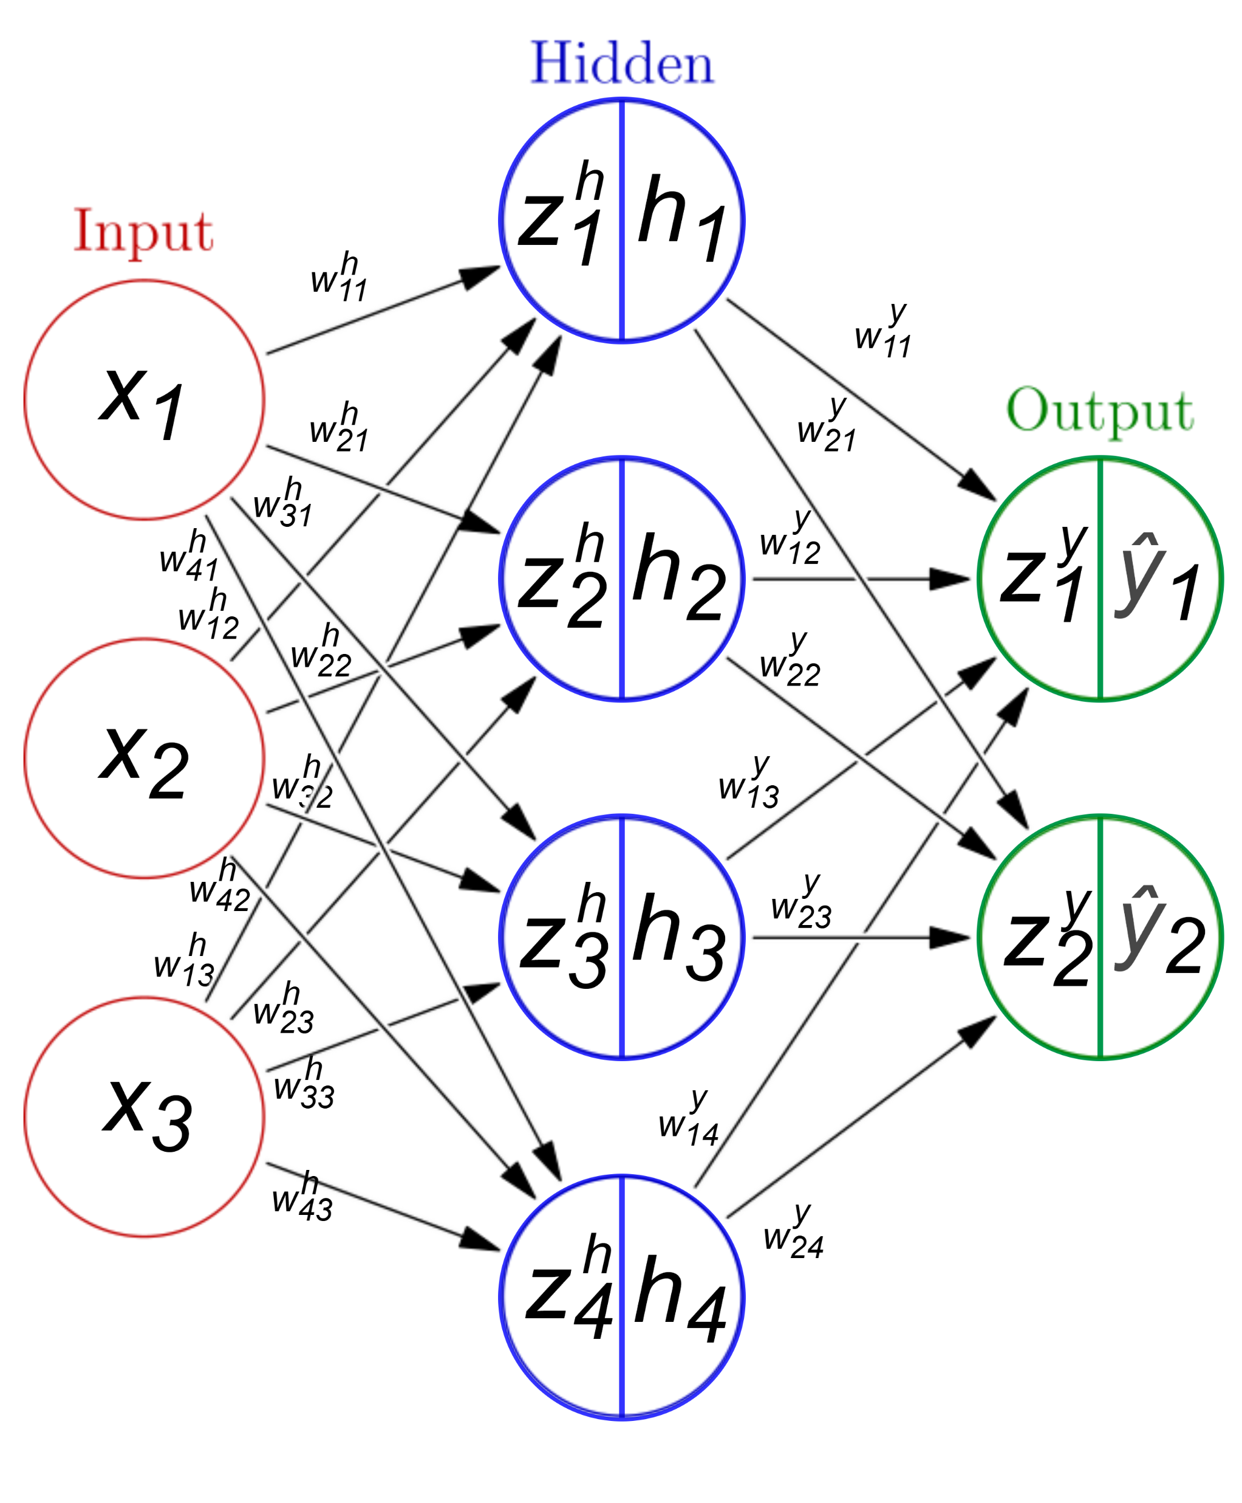
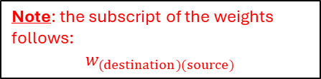
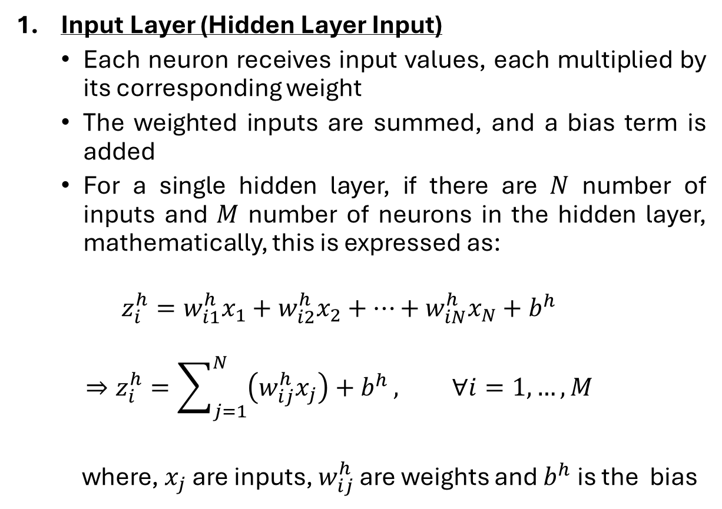
Forward Propagation
Input Layer (Hidden Layer Input)
Each neuron receives input values, each multiplied by its corresponding weight
The weighted inputs are summed, and a bias term is added
For a single hidden layer, if there are $N$ number of inputs and $M$ number of neurons in the hidden layer, mathematically, this is expressed as:
$$z_{i}^{h}=w_{i1}^{h}x_{1}+w_{i2}^{h}x_{2}+…+w_{iN}^{h}x_{N}+b^{h}$$
$$⇒z_{i}^{h}=\sum_{j=1}^{N}{\left(w_{ij}^{h}x_{j}\right)+b^{h}}, ∀i=1,…,M$$
where, $x_{j}$ are inputs, $w_{ij}^{h}$ are weights and $b^{h}$ is the bias
Note: the subscript of the weights follows:
$$w_{(destination)(source)}$$

Slide 7
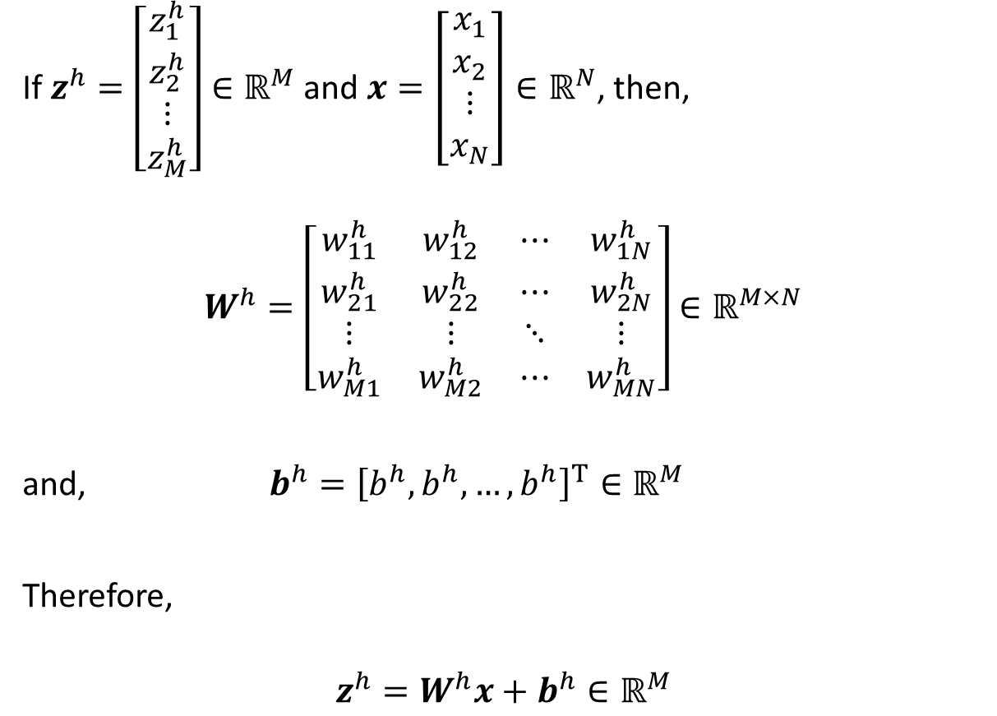
Forward Propagation (contd.)
If $z^{h}=\left[\begin{matrix}z_{1}^{h} \\ z_{2}^{h} \\ ⋮ \\ z_{M}^{h}\end{matrix}\right]∈ℝ^{M}$ and $x=\left[\begin{matrix}x_{1} \\ x_{2} \\ ⋮ \\ x_{N}\end{matrix}\right]∈ℝ^{N}$, then,
$$W^{h}=\left[\begin{matrix}w_{11}^{h} & w_{12}^{h} & ⋯ & w_{1N}^{h} \\ w_{21}^{h} & w_{22}^{h} & ⋯ & w_{2N}^{h} \\ ⋮ & ⋮ & ⋱ & ⋮ \\ w_{M1}^{h} & w_{M2}^{h} & ⋯ & w_{MN}^{h}\end{matrix}\right]∈ℝ^{M×N}$$
and, $b^{h}={\left[b^{h},b^{h},…,b^{h}\right]}^{T}∈ℝ^{M}$
Therefore,
$$z^{h}=W^{h}x+b^{h}∈ℝ^{M}$$

Slide 8
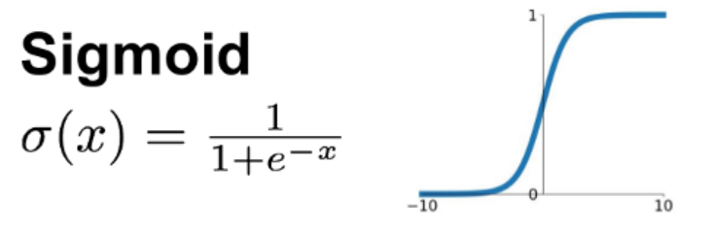
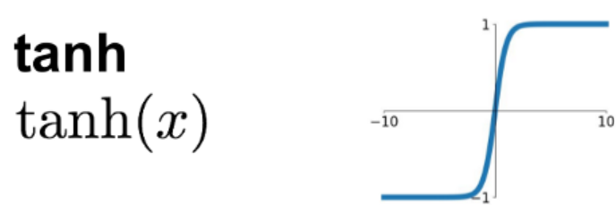
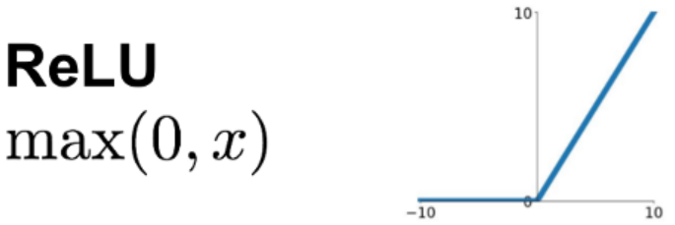
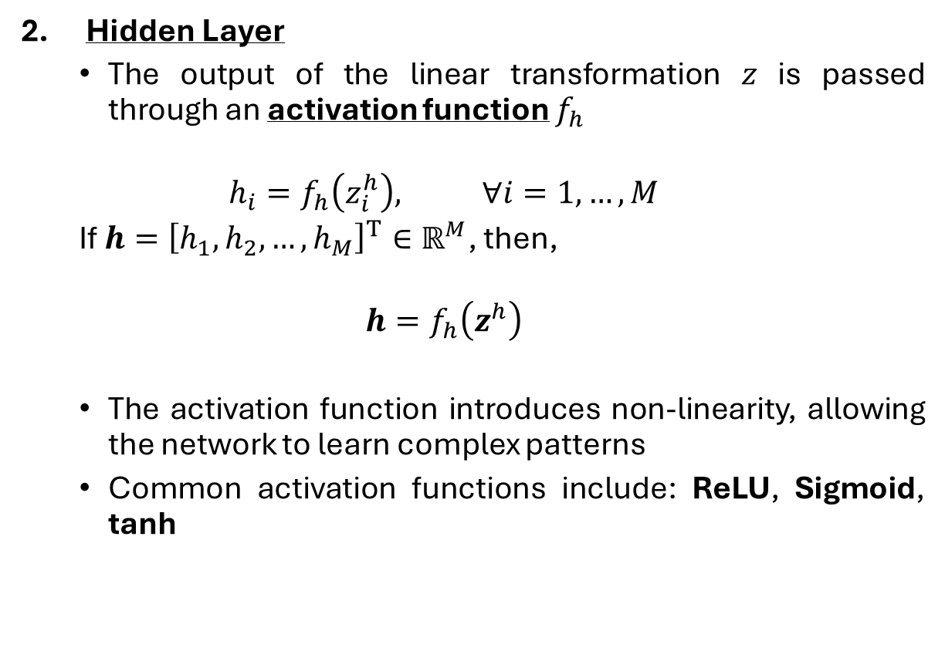
Forward Propagation (contd.)
Hidden Layer
The output of the linear transformation 𝑧 is passed through an activation function $f_{h}$
$$h_{i}=f_{h}\left(z_{i}^{h}\right), ∀i=1,…,M$$
If $h={\left[h_{1},h_{2},…,h_{M}\right]}^{T}∈ℝ^{M}$, then,
$$h=f_{h}\left(z^{h}\right)$$
The activation function introduces non-linearity, allowing the network to learn complex patterns
Common activation functions include: ReLU, Sigmoid, tanh

Slide 9
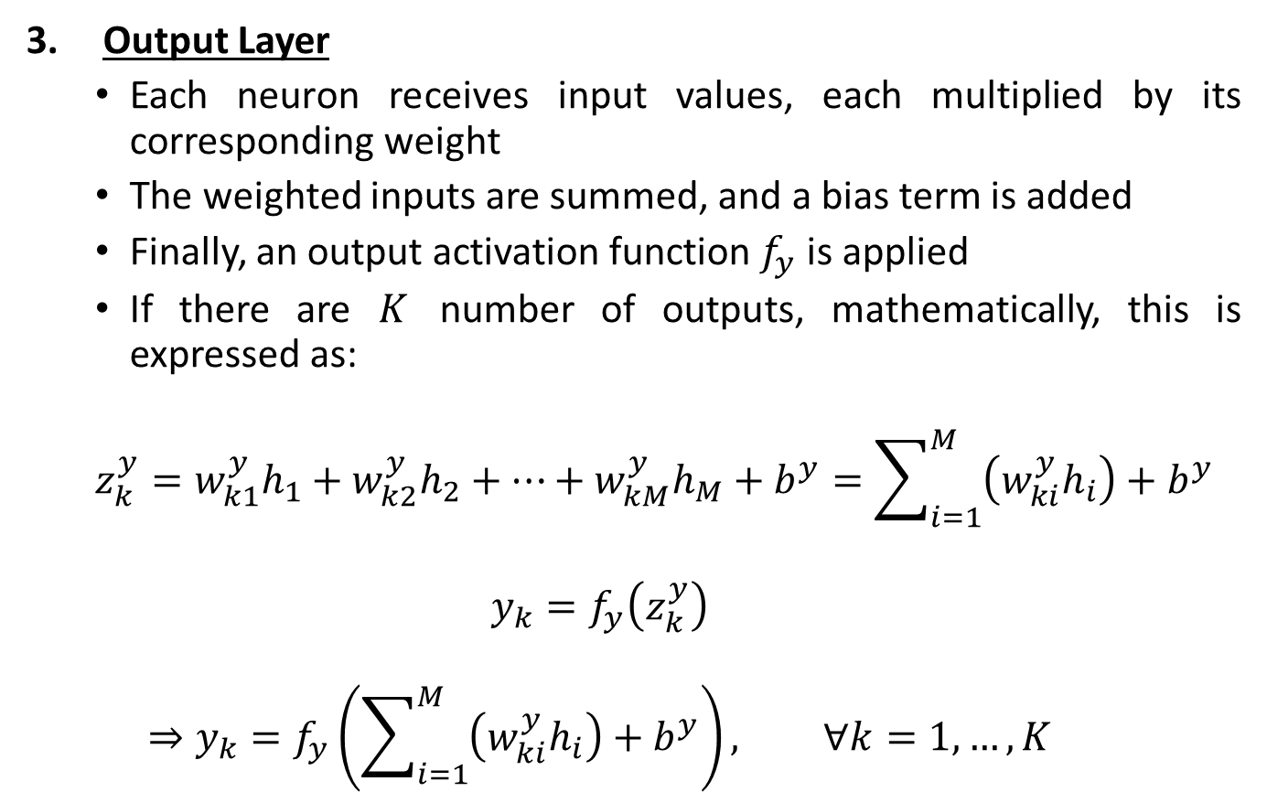
Forward Propagation (contd.)
Output Layer
Each neuron receives input values, each multiplied by its corresponding weight
The weighted inputs are summed, and a bias term is added
Finally, an output activation function $f_{y}$ is applied
If there are $K$ number of outputs, mathematically, this is expressed as:
$$z_{k}^{y}=w_{k1}^{y}h_{1}+w_{k2}^{y}h_{2}+…+w_{kM}^{y}h_{M}+b^{y}=\sum_{i=1}^{M}{\left(w_{ki}^{y}h_{i}\right)}+b^{y}$$
$$y_{k}=f_{y}\left(z_{k}^{y}\right)$$
$$⇒y_{k}=f_{y}\left(\sum_{i=1}^{M}{\left(w_{ki}^{y}h_{i}\right)}+b^{y}\right), ∀k=1,…,K$$

Slide 10
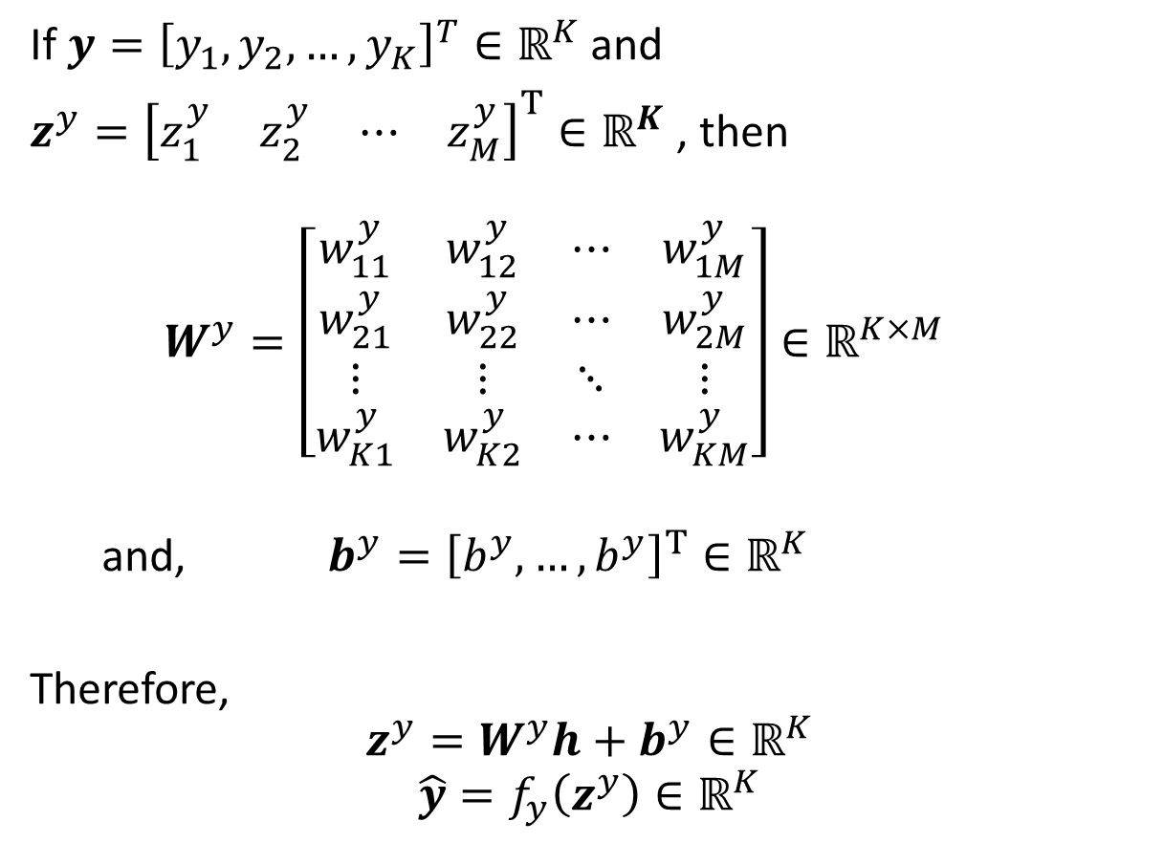
Forward Propagation (contd.)
If $y={\left[y_{1},y_{2},…,y_{K}\right]}^{T}∈ℝ^{K}$ and
$z^{y}={\left[\begin{matrix}z_{1}^{y} & z_{2}^{y} & ⋯ & z_{M}^{y}\end{matrix}\right]}^{T}∈ℝ^{K}$ , then
$$W^{y}=\left[\begin{matrix}w_{11}^{y} & w_{12}^{y} & ⋯ & w_{1M}^{y} \\ w_{21}^{y} & w_{22}^{y} & ⋯ & w_{2M}^{y} \\ ⋮ & ⋮ & ⋱ & ⋮ \\ w_{K1}^{y} & w_{K2}^{y} & ⋯ & w_{KM}^{y}\end{matrix}\right]∈ℝ^{K×M}$$
and, $b^{y}={\left[b^{y},…,b^{y}\right]}^{T}∈ℝ^{K}$
Therefore,
$$z^{y}=W^{y}h+b^{y}∈ℝ^{K}$$
$$\hat{y}=f_{y}\left(z^{y}\right)∈ℝ^{K}$$

Slide 11
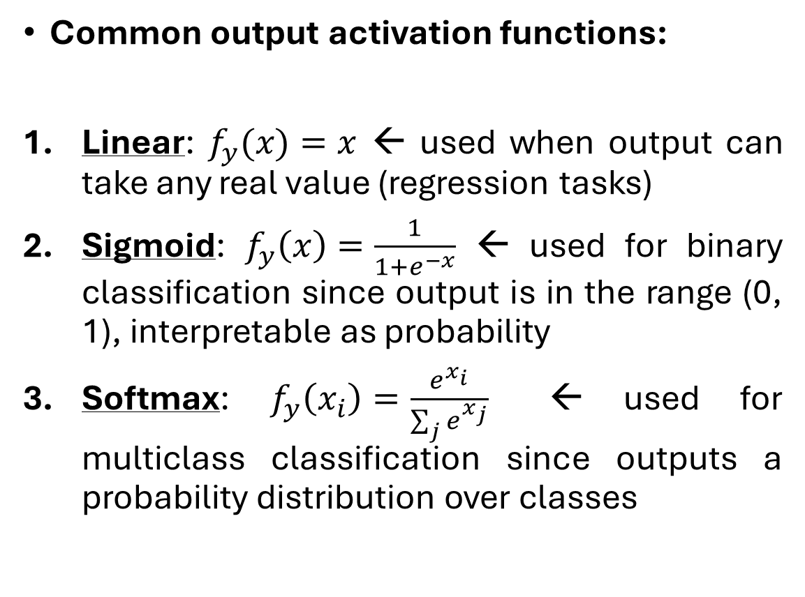
Forward Propagation (contd.)
Common output activation functions:
Linear: $f_{y}(x)=x$ ← used when output can take any real value (regression tasks)
Sigmoid: $f_{y}\left(x\right)=\frac{1}{1+e^{−x}}$ ← used for binary classification since output is in the range (0, 1), interpretable as probability
Softmax: $f_{y}\left(x_{i}\right)=\frac{e^{x_{i}}}{\sum_{j}{e^{x_{j}}}}$ ← used for multiclass classification since outputs a probability distribution over classes

Slide 12
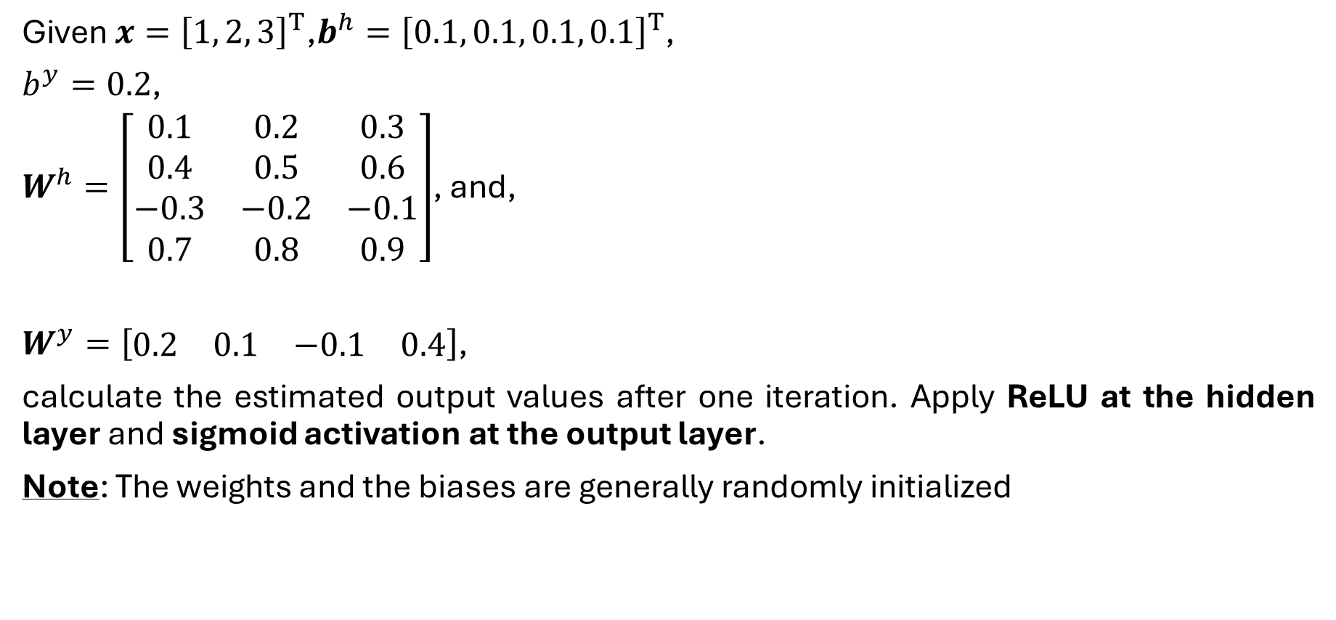
Forward Propagation: Example
Given $x={\left[1, 2, 3\right]}^{T}$,$b^{h}={\left[0.1, 0.1, 0.1, 0.1\right]}^{T}$,
$b^{y}=0.2$,
$W^{h}=\left[\begin{matrix}0.1 & 0.2 & 0.3 \\ 0.4 & 0.5 & 0.6 \\ −0.3 & −0.2 & −0.1 \\ 0.7 & 0.8 & 0.9\end{matrix}\right]$, and,
$W^{y}=\left[\begin{matrix}0.2 & 0.1 & −0.1 & 0.4\end{matrix}\right]$,
calculate the estimated output values after one iteration. Apply ReLU at the hidden layer and sigmoid activation at the output layer.
Note: The weights and the biases are generally randomly initialized

Slide 13
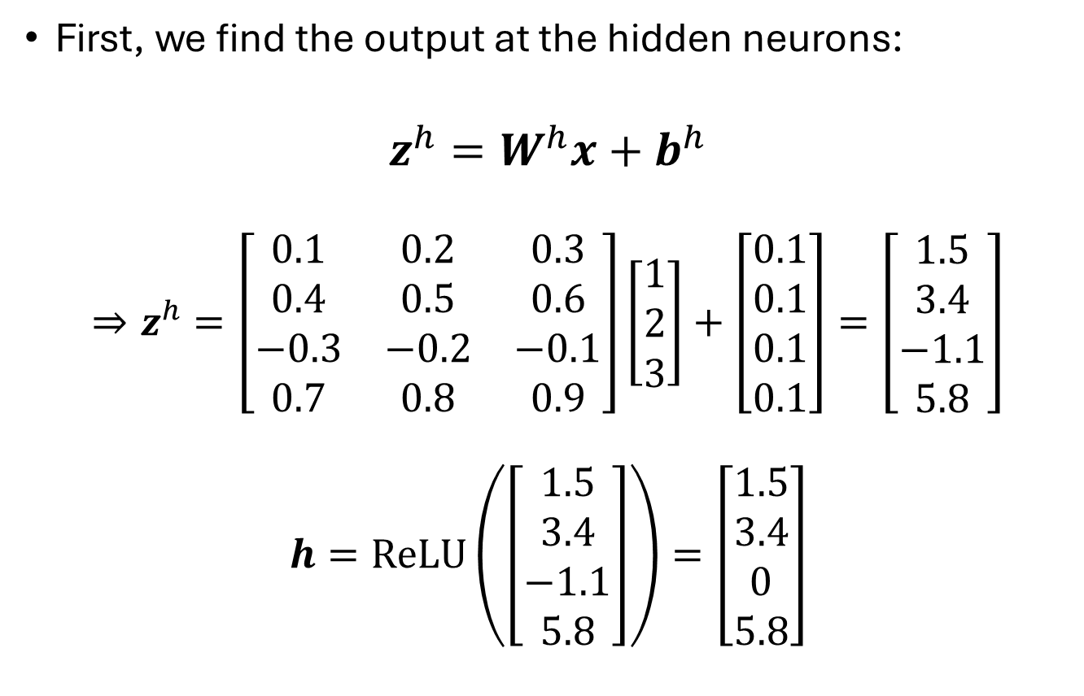
Forward Propagation: Example (contd.)
First, we find the output at the hidden neurons:
$$z^{h}=W^{h}x+b^{h}$$
$$⇒z^{h}=\left[\begin{matrix}0.1 & 0.2 & 0.3 \\ 0.4 & 0.5 & 0.6 \\ −0.3 & −0.2 & −0.1 \\ 0.7 & 0.8 & 0.9\end{matrix}\right]\left[\begin{matrix}1 \\ 2 \\ 3\end{matrix}\right]+\left[\begin{matrix}0.1 \\ 0.1 \\ 0.1 \\ 0.1\end{matrix}\right]=\left[\begin{matrix}1.5 \\ 3.4 \\ −1.1 \\ 5.8\end{matrix}\right]$$
$$h=ReLU\left(\left[\begin{matrix}1.5 \\ 3.4 \\ −1.1 \\ 5.8\end{matrix}\right]\right)=\left[\begin{matrix}1.5 \\ 3.4 \\ 0 \\ 5.8\end{matrix}\right]$$

Slide 14

Forward Propagation: Example (contd.)
Next, we find the output at the output layer:
$$z^{y}=W^{y}h+b^{y}$$
$$⇒z_{y}=\left[\begin{matrix}0.2 & 0.1 & −0.1 & 0.4\end{matrix}\right]\left[\begin{matrix}1.5 \\ 3.4 \\ 0 \\ 5.8\end{matrix}\right]+0.2=3.16$$
$$y=f_{y}\left(z_{y}\right)=\frac{1}{1+e^{3.16}}=0.960$$

Slide 15
Backpropagation
After forward propagation, the network evaluates how well it performed using a loss function that measures the error between predicted and actual outputs.
The objective of training is to minimize this loss, and backpropagation is the method used to do that.
Loss Calculation:
Computes the error in predictions
Common loss functions: Mean Squared Error (MSE) and Root Mean Squared Error (RMSE) for regression, Cross-Entropy for classification
Gradient Calculation:
Calculates how much each weight and bias contributes to the loss
Uses the chain rule from calculus to compute partial derivatives
Weight Update:
Updates weights and biases using an optimizer like Stochastic Gradient Descent (SGD)
Adjustments are made in the opposite direction of the gradient
The learning rate controls how large each update step is

Slide 16
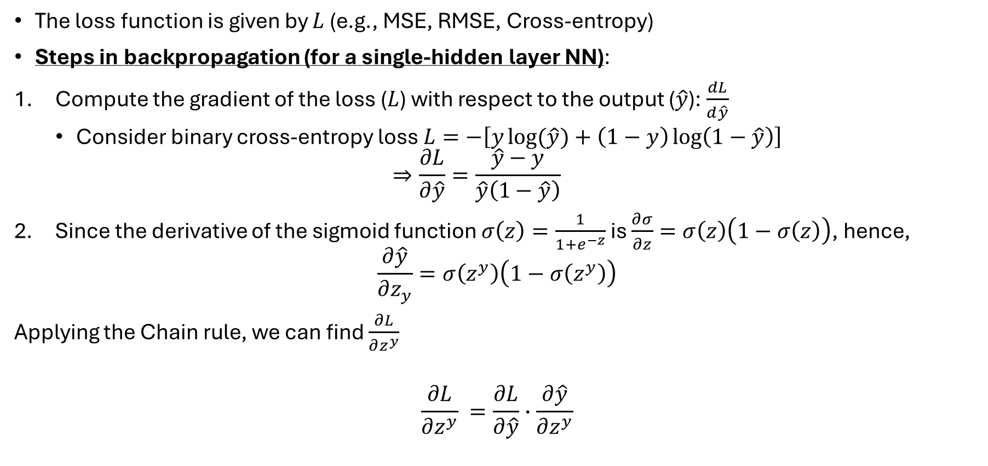
Backpropagation (contd.)
The loss function is given by $L$ (e.g., MSE, RMSE, Cross-entropy)
Steps in backpropagation (for a single-hidden layer NN):
Compute the gradient of the loss ($L$) with respect to the output ($\hat{y}$): $\frac{dL}{d\hat{y}}$
Consider binary cross-entropy loss $L=−\left[y\log{(\hat{y})}+\left(1−y\right)\log\left(1−\hat{y}\right)\right]$
$$⇒\frac{∂L}{∂\hat{y}}=\frac{\hat{y}−y}{\hat{y}\left(1−\hat{y}\right)}$$
Since the derivative of the sigmoid function $σ\left(z\right)=\frac{1}{1+e^{−z}}$ is $\frac{∂σ}{∂z}=σ\left(z\right)\left(1−σ\left(z\right)\right)$, hence,
$$\frac{∂\hat{y}}{∂z_{y}}=σ\left(z^{y}\right)\left(1−σ\left(z^{y}\right)\right)$$
Applying the Chain rule, we can find $\frac{∂L}{∂z^{y}}$
$$\frac{∂L}{∂z^{y}} =\frac{∂L}{∂\hat{y}}∙\frac{∂\hat{y}}{∂z^{y}}$$

Slide 17
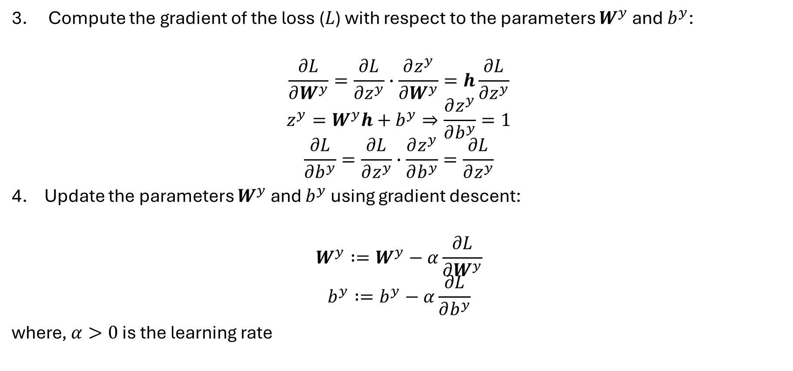
Backpropagation (contd.)
Compute the gradient of the loss ($L$) with respect to the parameters $W^{y}$ and $b^{y}$:
$$\frac{∂L}{∂W^{y}}=\frac{∂L}{∂z^{y}}∙\frac{∂z^{y}}{∂W^{y}}=h\frac{∂L}{∂z^{y}}$$
$$z^{y}=W^{y}h+b^{y}⇒\frac{∂z^{y}}{∂b^{y}}=1$$
$$\frac{∂L}{∂b^{y}}=\frac{∂L}{∂z^{y}}∙\frac{∂z^{y}}{∂b^{y}}=\frac{∂L}{∂z^{y}}$$
Update the parameters $W^{y}$ and $b^{y}$ using gradient descent:
$$W^{y} :=W^{y}−α\frac{∂L}{∂W^{y}}$$
$$b^{y} :=b^{y}−α\frac{∂L}{∂b^{y}}$$
where, $α>0$ is the learning rate

Slide 18
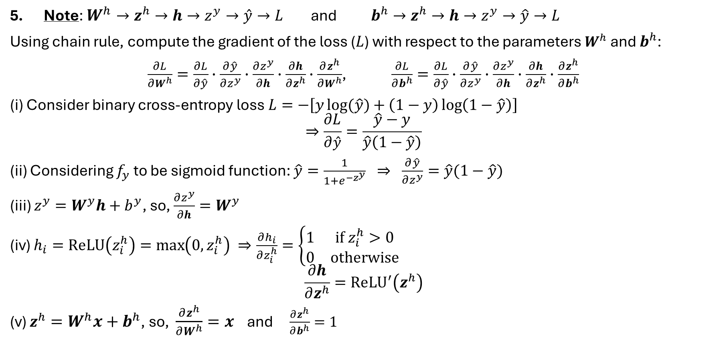
Backpropagation (contd.)
Note: $W^{h}→z^{h}→h→z^{y}→\hat{y}→L$ and $b^{h}→z^{h}→h→z^{y}→\hat{y}→L$
Using chain rule, compute the gradient of the loss ($L$) with respect to the parameters $W^{h}$ and $b^{h}$:
$\frac{∂L}{∂W^{h}}=\frac{∂L}{∂\hat{y}}∙\frac{∂\hat{y}}{∂z^{y}}∙\frac{∂z^{y}}{∂h}∙\frac{∂h}{∂z^{h}}∙\frac{∂z^{h}}{∂W^{h}}$, $\frac{∂L}{∂b^{h}}=\frac{∂L}{∂\hat{y}}∙\frac{∂\hat{y}}{∂z^{y}}∙\frac{∂z^{y}}{∂h}∙\frac{∂h}{∂z^{h}}∙\frac{∂z^{h}}{∂b^{h}}$
(i) Consider binary cross-entropy loss $L=−\left[y\log{(\hat{y})}+\left(1−y\right)\log\left(1−\hat{y}\right)\right]$
$$⇒\frac{∂L}{∂\hat{y}}=\frac{\hat{y}−y}{\hat{y}\left(1−\hat{y}\right)}$$
(ii) Considering $f_{y}$ to be sigmoid function: $\hat{y}=\frac{1}{1+e^{−z^{y}}} ⇒ \frac{∂\hat{y}}{∂z^{y}}=\hat{y}(1−\hat{y})$
(iii) $z^{y}=W^{y}h+b^{y}$, so, $\frac{∂z^{y}}{∂h}=W^{y}$
(iv) $h_{i}=ReLU\left(z_{i}^{h}\right)=\max\left(0,z_{i}^{h}\right) ⇒\frac{∂h_{i}}{∂z_{i}^{h}}=\left\{\begin{matrix}1 & if z_{i}^{h}>0 \\ 0 & otherwise\end{matrix}\right.$
$$\frac{∂h}{∂z^{h}}=ReLU^{′}\left(z^{h}\right)$$
(v) $z^{h}=W^{h}x+b^{h}$, so, $\frac{∂z^{h}}{∂W^{h}}=x$ and $\frac{∂z^{h}}{∂b^{h}}=1$

Slide 19

Backpropagation (contd.)
Update the parameters $W^{h}$ and $b^{h}$ using gradient descent:
$$W^{h} :=W^{h}−α\frac{∂L}{∂W^{h}}$$
$$b^{h} :=b^{h}−α\frac{∂L}{∂b^{h}}$$

Slide 20
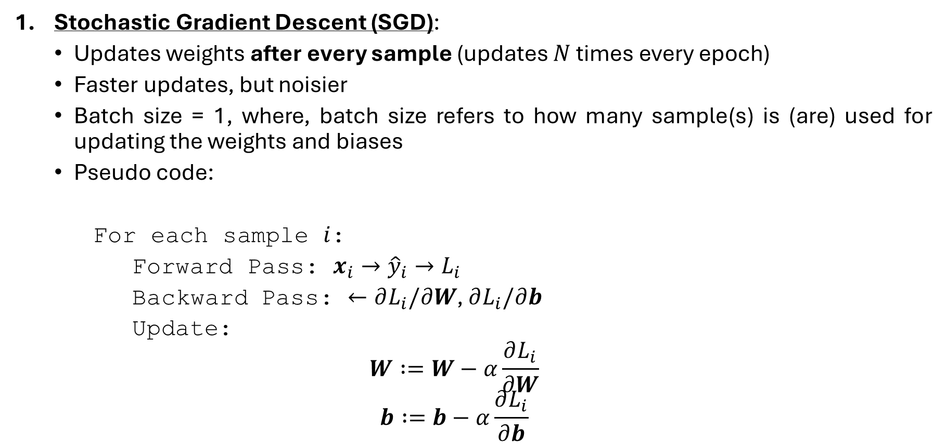
Updating Modes
Stochastic Gradient Descent (SGD):
Updates weights after every sample (updates $N$ times every epoch)
Faster updates, but noisier
Batch size = 1, where, batch size refers to how many sample(s) is (are) used for updating the weights and biases
Pseudo code:
For each sample $i$:
Forward Pass: $x_{i}→{\hat{y}}_{i}→L_{i}$
Backward Pass: $←∂L_{i}/∂W$, $∂L_{i}/∂b$
Update:
$$W :=W−α\frac{∂L_{i}}{∂W}$$
$$b :=b−α\frac{∂L_{i}}{∂b}$$

Slide 21
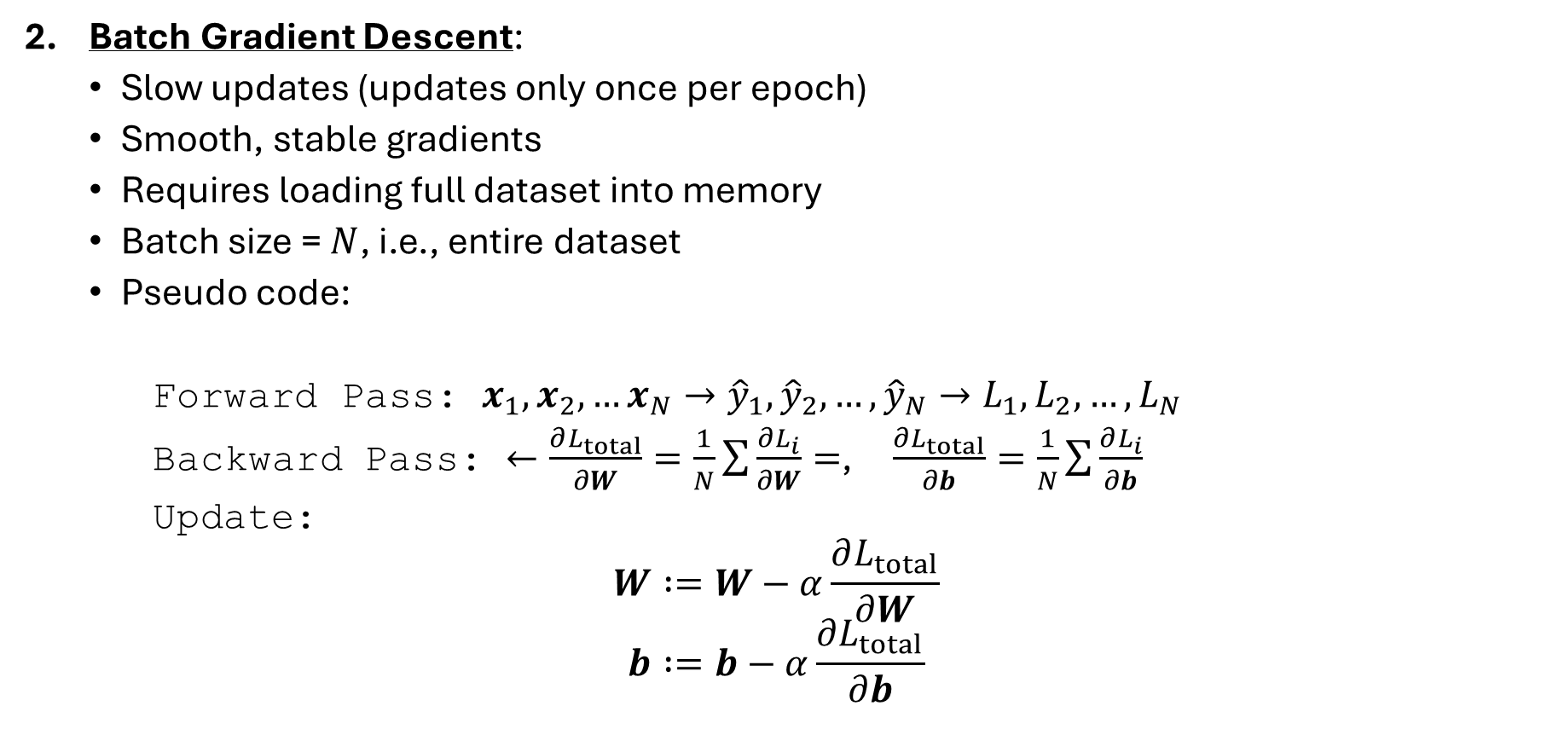
Updating Modes (contd.)
Batch Gradient Descent:
Slow updates (updates only once per epoch)
Smooth, stable gradients
Requires loading full dataset into memory
Batch size = $N$, i.e., entire dataset
Pseudo code:
Forward Pass: $x_{1},x_{2},…x_{N}→{\hat{y}}_{1},{\hat{y}}_{2},…,{\hat{y}}_{N}→L_{1},L_{2},…,L_{N}$
Backward Pass: $←\frac{∂L_{total}}{∂W}=\frac{1}{N}\sum{\frac{∂L_{i}}{∂W}=}$, $\frac{∂L_{total}}{∂b}=\frac{1}{N}\sum{\frac{∂L_{i}}{∂b}}$
Update:
$$W :=W−α\frac{∂L_{total}}{∂W}$$
$$b :=b−α\frac{∂L_{total}}{∂b}$$

Slide 22
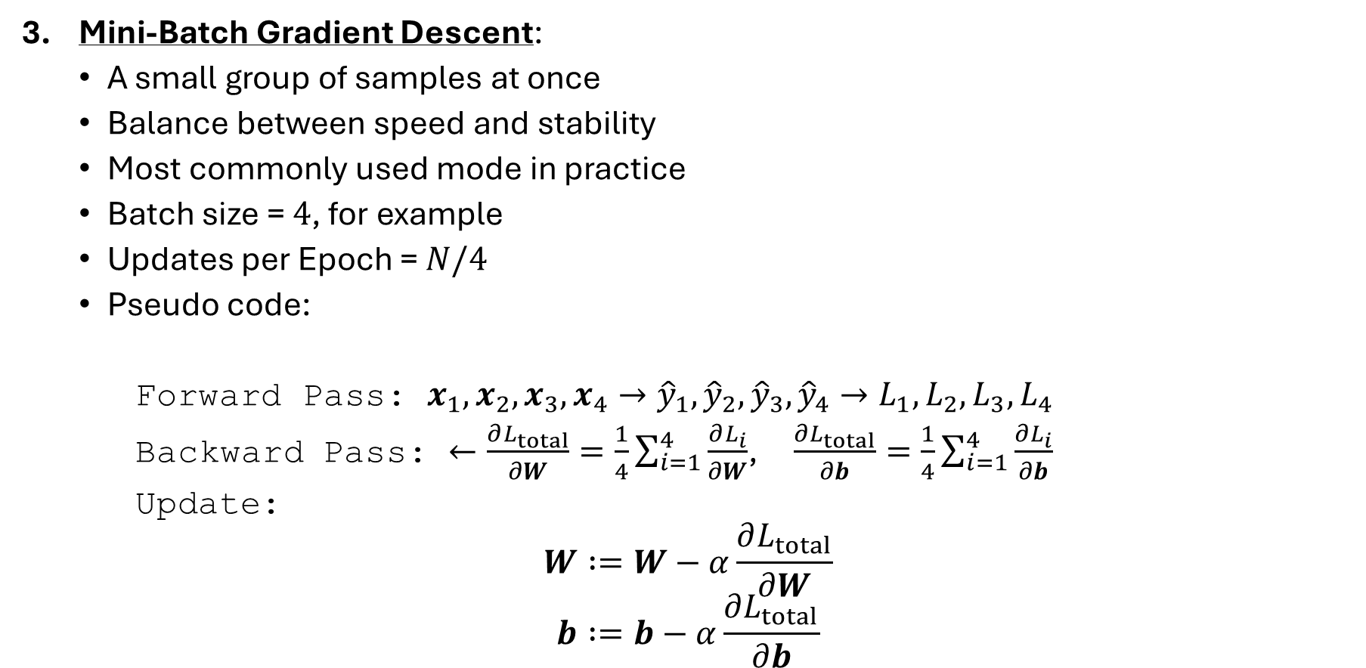
Updating Modes (contd.)
Mini-Batch Gradient Descent:
A small group of samples at once
Balance between speed and stability
Most commonly used mode in practice
Batch size = $4$, for example
Updates per Epoch = $N/4$
Pseudo code:
Forward Pass: $x_{1},x_{2},x_{3},x_{4}→{\hat{y}}_{1},{\hat{y}}_{2},{\hat{y}}_{3},{\hat{y}}_{4}→L_{1},L_{2},L_{3},L_{4}$
Backward Pass: $←\frac{∂L_{total}}{∂W}=\frac{1}{4}\sum_{i=1}^{4}{\frac{∂L_{i}}{∂W}}$, $\frac{∂L_{total}}{∂b}=\frac{1}{4}\sum_{i=1}^{4}{\frac{∂L_{i}}{∂b}}$
Update:
$$W :=W−α\frac{∂L_{total}}{∂W}$$
$$b :=b−α\frac{∂L_{total}}{∂b}$$

Slide 23
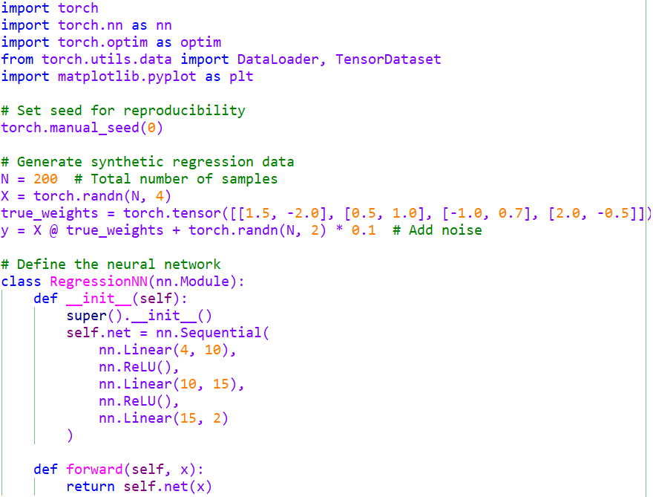
Example using PyTorch Library

Slide 24
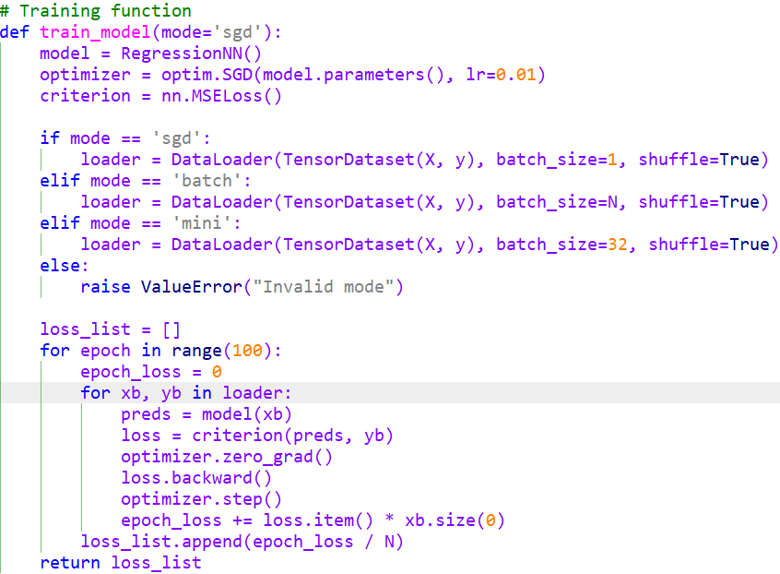
Example using PyTorch Library (contd.)

Slide 25
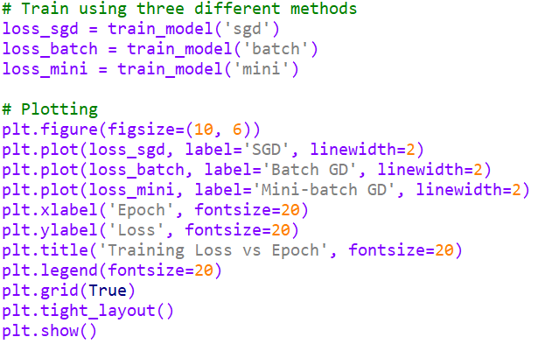
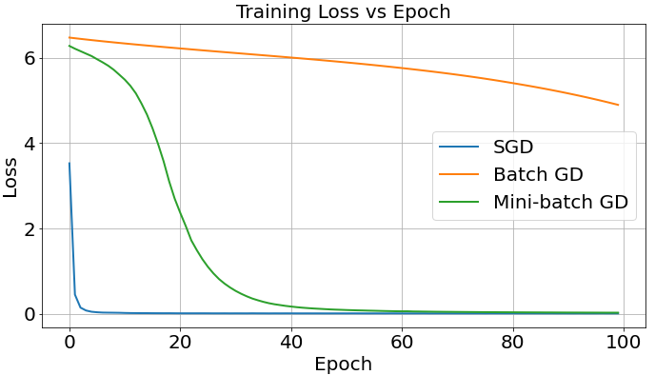
Example using PyTorch Library (contd.)

Slide 26
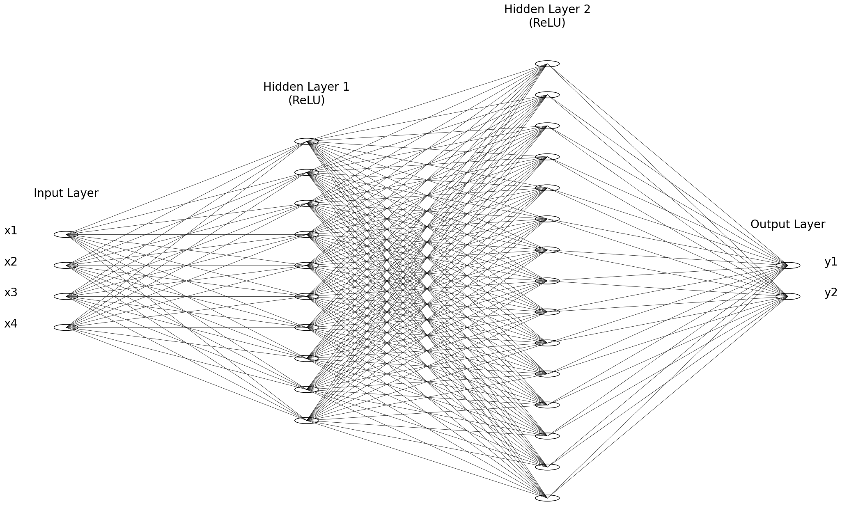
Example using PyTorch Library (contd.)

